Slide 1
Bayesian Hierarchical Models – an introduction
Kate Searle

Slide 2
Motivation for using hierarchical Bayes…
Why Bayes?
All scientific models are abstractions
Because models are abstractions and reduce the dimensions of a problem, we must deal with the elements we choose to leave out
so assessing uncertainty is fundamental to science:
“process uncertainty”
“observation uncertainty”
Why hierarchical models?
Allow us to decompose complex, high dimensional problems into parts that can be thought about and analysed individually
Broad and flexible approach, allowing us to tackle virtually any ecological problem

Slide 3
Ecological systems are fundamentally hierarchical in nature…

Slide 4
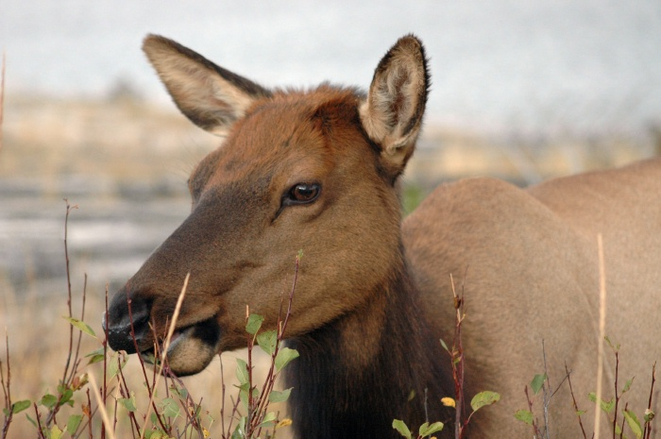
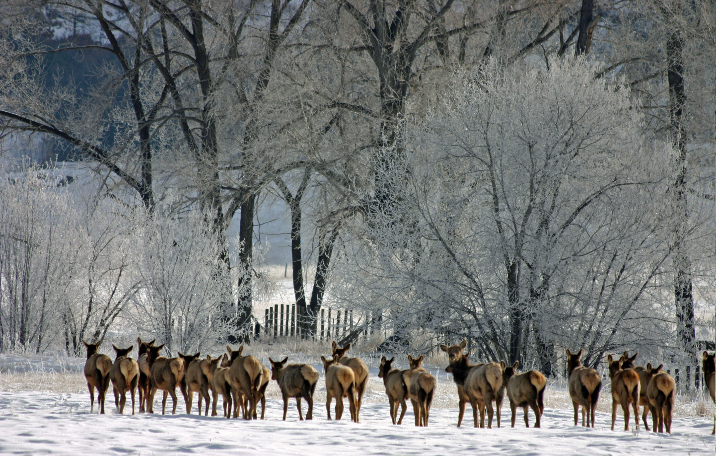
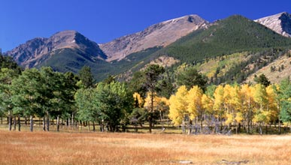
Ecological variation – levels of biological organisation
Spatial and temporal heterogeneity
Scale
Individuals
Populations
Communities and Ecosystems

Slide 5
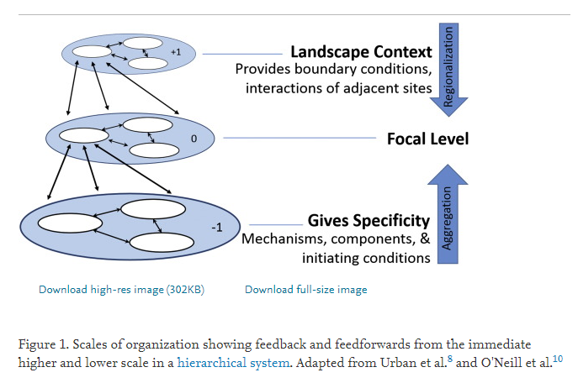
Ecological variation – spatial scales
Landscape
Habitat type
Plots
Individual plants
Adapted from Salley et al. 2016. Rangelands 38(6):313—317 doi: 10.1016/j.rala.2016.10.003

Slide 6
Ecological research commonly has to deal with issues such as:
Variation among individuals (e.g., location or genotype)
Ecological processes operating at more than one spatial scale (plot → habitat type) or level of ecological organisation (individuals → populations → communities)
The need to accommodate uncertainty arising from modelling a process as well as uncertainty derived from imperfect observations
Dealing with changes in state that cannot be observed directly (age transitions of individuals that are hard to observe)
Hierarchical models provide a natural framework for addressing all of these issues

Slide 7
Ecological systems are fundamentally hierarchical in nature…
…so it follows that our models should be hierarchical, also

Slide 8
A framework for thinking about and fitting Bayesian hierarchical models in ecology…

Slide 9
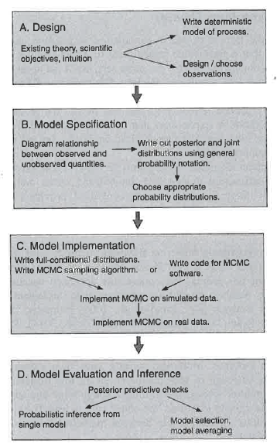
Modelling in Ecology using Bayes
Define question, think about ecological process and observations
Define the model to represent the ecological process and observations
Diagram it
Write out posterior and joint distributions
Choose probability distributions
Implement the model using your expression for the posterior and joint distributions
Perform model checking
Hobbs & Hooten (2015)

Slide 10
Part 1: defining our model and its relationship to our data
Define question, think about ecological process and observations
Define the model to represent the ecological process and observations
Diagram it
Write out posterior and joint distributions
Choose probability distributions

Slide 11
Part 2: implementing our model using MCMC (R and JAGS)
Implement the model using your expression for the posterior and joint distributions

Slide 12
Part 1: defining our model and its relationship to our data
Define question, think about ecological process and observations
Define the model to represent the ecological process and observations
Diagram it
Write out posterior and joint distributions
Choose probability distributions

Slide 13
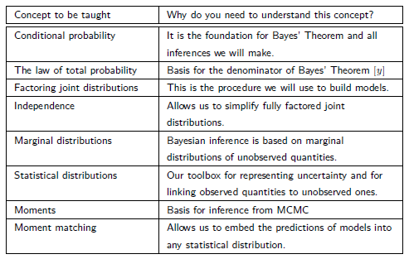
Start with the fundamentals…
From Tom Hobbs, Colorado State University

Slide 14
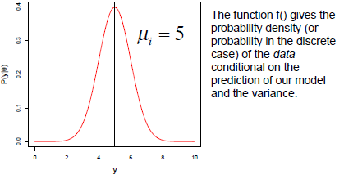
Start with the fundamentals …
Random variables
A random variable is a quantity whose values are subject to chance
The values it may take are governed by a probability distribution
Bayesian inference treats all unobserved quantities as random variables
Our goal in Bayesian modelling is to understand those distributions (draw inference about unobserved quantities)

Slide 15
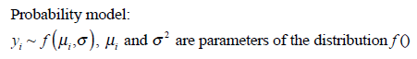
Start with the fundamentals …
Probability distributions
The values of random variables are governed by a probability distribution
From Tom Hobbs, Colorado State University

Slide 16
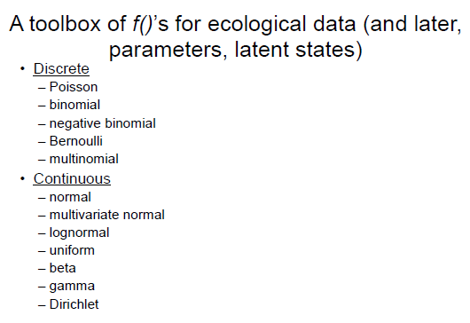
Start with the fundamentals …
From Tom Hobbs, Colorado State University

Slide 17
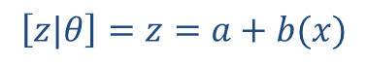
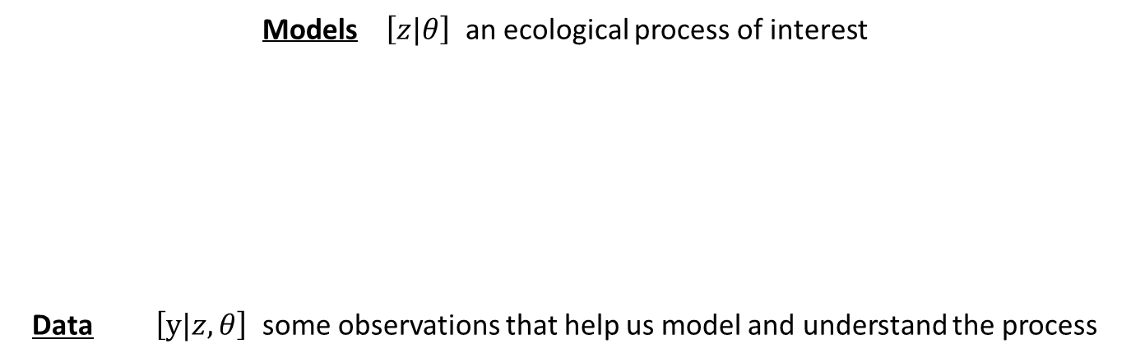
Start with the fundamentals …
Our line of inference for defining models and data within the Bayesian framework…
We need a way to talk about models and data:
Models $\left[z|θ\right]$ an ecological process of interest
Data $\left[y|z,θ\right]$ some observations that help us model and understand the process
State we are trying to model
Parameters of interest
$$\left[z|θ\right]=z=a+b(x)$$
We learn about the process (our model) using our data
Data observations
Model

Slide 18
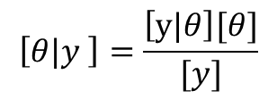
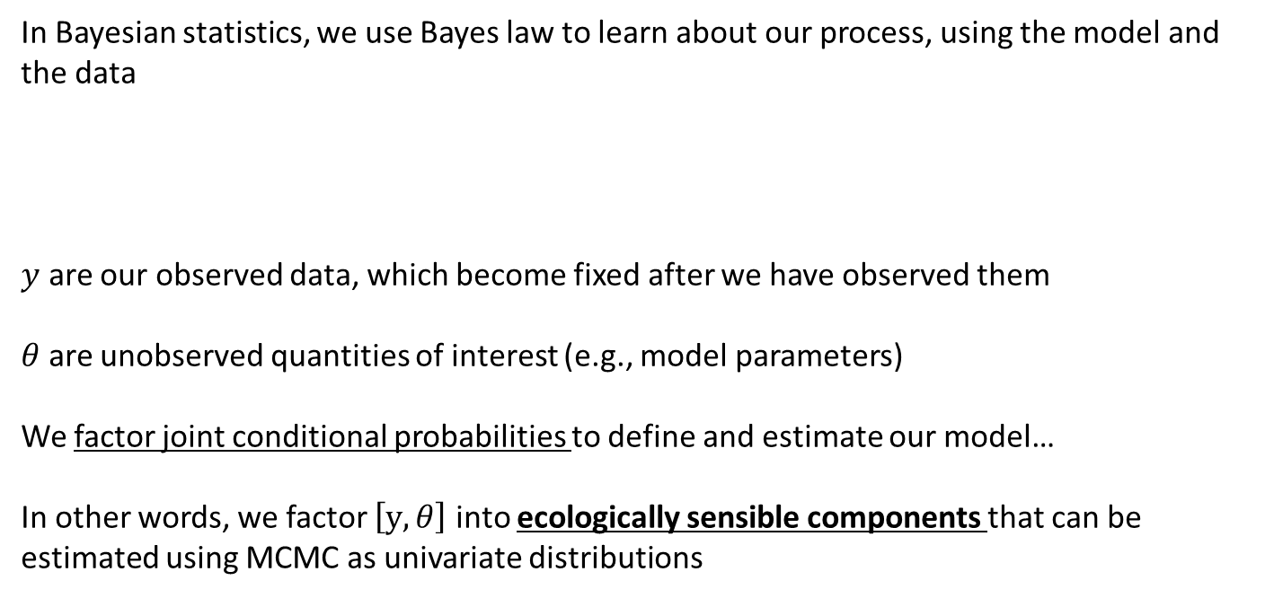
Start with the fundamentals…Bayes law
Our line of inference for defining models and data within the Bayesian framework
In Bayesian statistics, we use Bayes law to learn about our process, using the model and the data
$y$ are our observed data, which become fixed after we have observed them
$θ$ are unobserved quantities of interest (e.g., model parameters)
We factor joint conditional probabilities to define and estimate our model…
In other words, we factor $\left[y,θ\right]$ into ecologically sensible components that can be estimated using MCMC as univariate distributions
$$\left[θ|y \right]=\frac{\left[y|θ\right][θ]}{[y]}$$
Allows us to decompose complex, high dimensional problems into parts that can be thought about and analysed individually

Slide 19
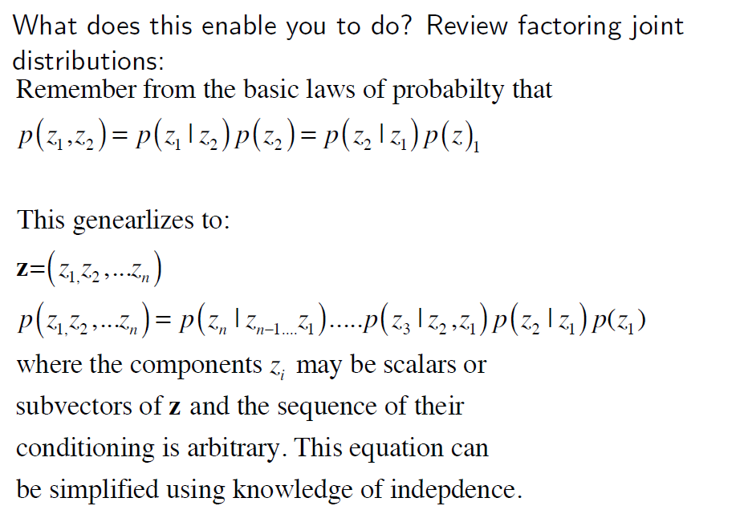
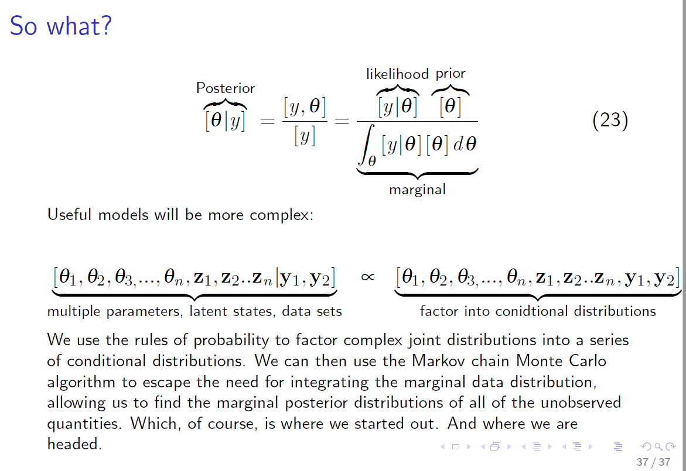
Why is factoring joint conditional distributions so important?
Factoring joint distributions allows us to decompose complex, high dimensional problems into parts that can be thought about and analysed individually
The sequence of conditioning is arbitrary, when we build models we choose a sequence that makes sense
Useful, ecological models will be more complex…
And we use MCMC to find the marginal posterior distributions of all the unobserved quantities
1
Bayes law:
Multiple parameters, latent states, multiple datasets
Factor into conditional distributions

Slide 20
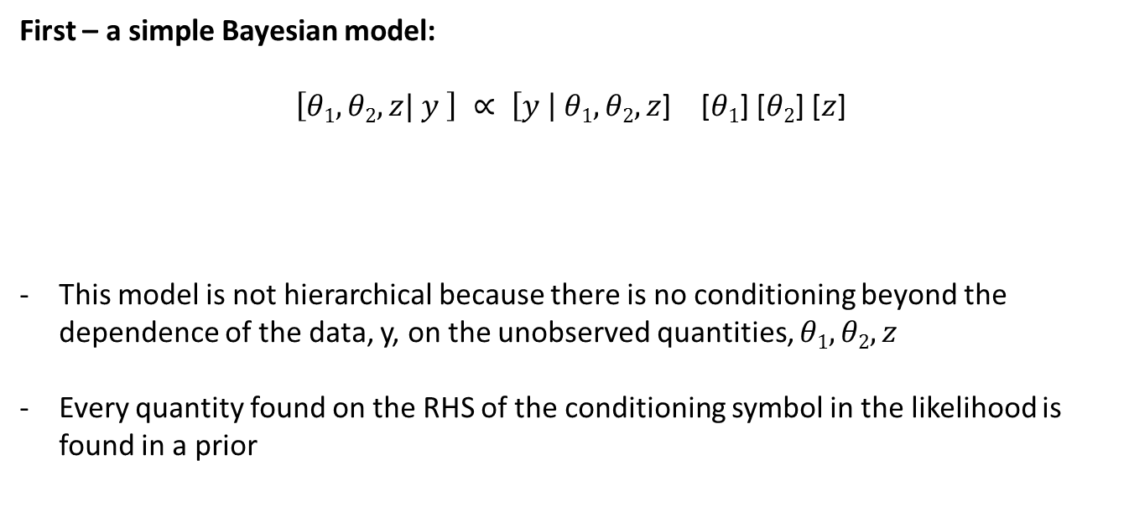
Fundamentally, we need to be able to write out our ecological problem as follows…
First – a simple Bayesian model:
$\left[θ1,θ2,z| y \right] ∝ \left[y \right| θ1,θ2,z$] [$θ1$] [$θ2$] [$z$]
This model is not hierarchical because there is no conditioning beyond the dependence of the data, y, on the unobserved quantities, $θ1,θ2,z$
Every quantity found on the RHS of the conditioning symbol in the likelihood is found in a prior
Joint distribution
Posterior
unobserved
Likelihood
Priors
observed
Let’s all just take a moment to stare at this, and make sure we get it…

Slide 21
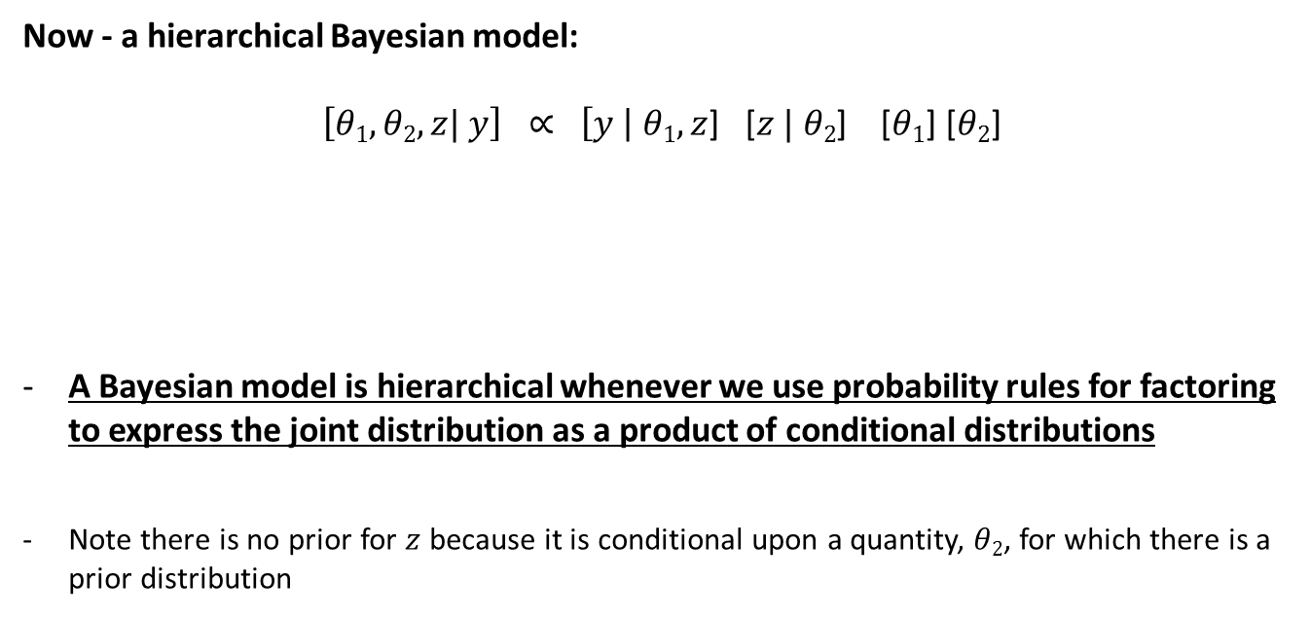
Fundamentally, we need to be able to write out our ecological problem as follows…
Now - a hierarchical Bayesian model:
$\left[θ1,θ2,z| y\right] ∝ \left[y \right| θ1,z$] [$z | θ2$] [$θ1$] [$θ2$]
A Bayesian model is hierarchical whenever we use probability rules for factoring to express the joint distribution as a product of conditional distributions
Note there is no prior for $z$ because it is conditional upon a quantity, $θ2$, for which there is a prior distribution
Joint distribution
Posterior
unobserved
Likelihood (product of two conditional distributions)
Priors
observed
Cue more staring….

Slide 22
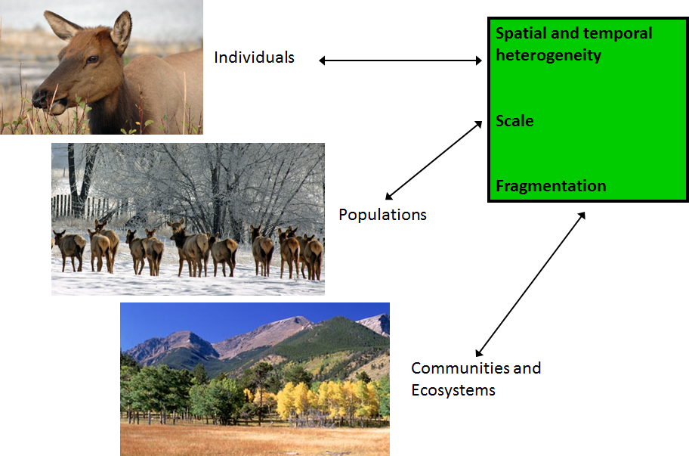
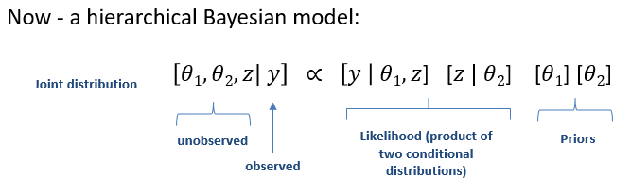
Summary: how does this help us with ecological models?
We use our knowledge of:
ecological systems (the context)
the ecological process
how we observe the process
the assumptions we make to simplify it
(represent it as a model) and the parts we
have left out

Slide 23
The mechanics…
How do we go from our conceptual understanding of an ecological process and our data…
…to a fully functioning model we can fit?

Slide 24
Start with the fundamentals …
From Tom Hobbs, Colorado State University
We need to be able to define our model in terms of a set of factored joint distributions
Conceptual model →
Factored joint distribution for the posterior

Slide 25
Graphical modelling, or
Directed Acyclic Graphs (DAGs)

Slide 26
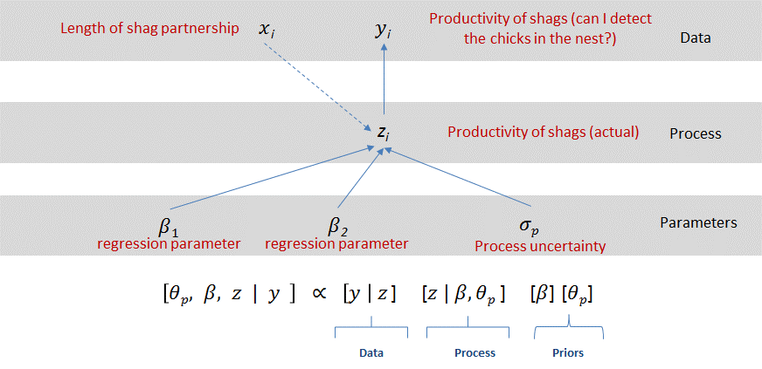
DAG and factoring practice:
Diagramming joint and conditional probabilities
An ecological model – coming up later….
….but first, something simpler!

Slide 27
Bayesian networks or directed acyclic graphs (DAGs)
We use these to draw and then write out factored expressions for joint distributions
The expression for the joint distribution is then implemented within a statistical package (e.g., BUGS, JAGS, STAN) to fit the model and estimate the parameters of interest
Define question, think about ecological process and observations
Define the model to represent the ecological process and observations
Diagram it
Write out posterior and joint distributions
Choose probability distributions

Slide 28
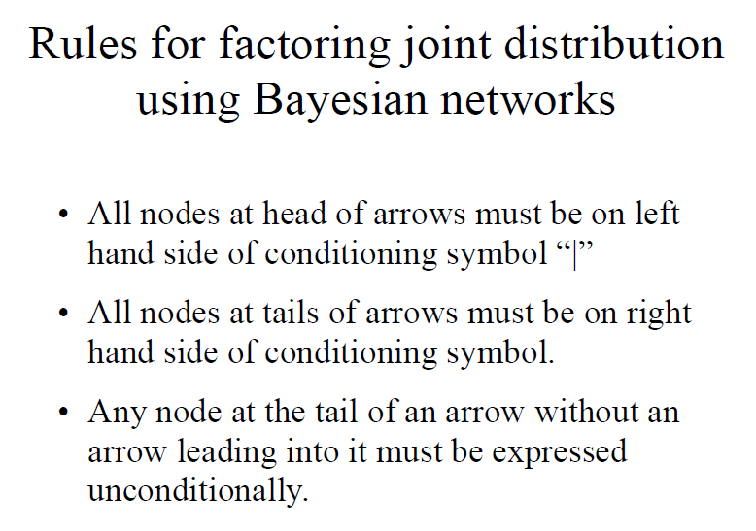
A
B
C

Slide 29
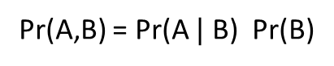
A
Pr(A,B) = Pr(A $|$ B) Pr(B)
B

Slide 30
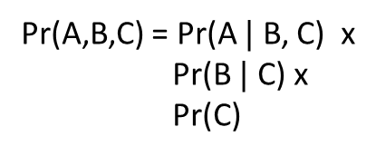
A
Pr(A,B,C) = Pr(A $|$ B, C) x
Pr(B $|$ C) x
Pr(C)
B
C

Slide 31
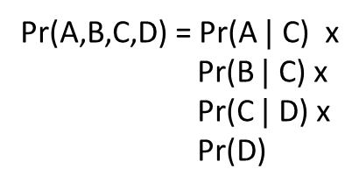
A
B
Pr(A,B,C,D) = Pr(A $|$ C) x
Pr(B $|$ C) x
Pr(C $|$ D) x
Pr(D)
C
D

Slide 32
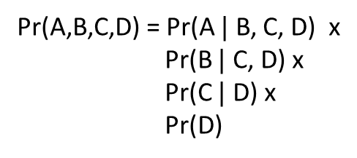
A
B
C
Pr(A,B,C,D) = Pr(A $|$ B, C, D) x
Pr(B $|$ C, D) x
Pr(C $|$ D) x
Pr(D)
D

Slide 33
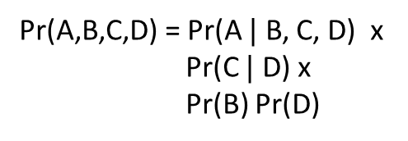
A
B
C
Pr(A,B,C,D) = Pr(A $|$ B, C, D) x
Pr(C $|$ D) x
Pr(B) Pr(D)
D

Slide 34
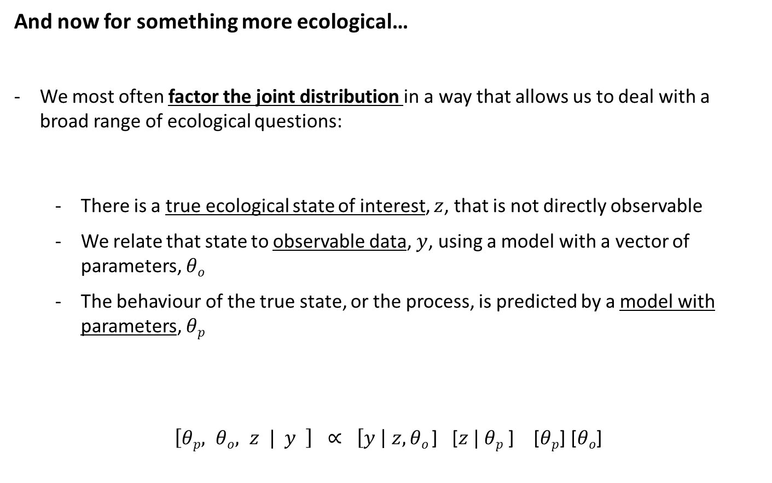
And now for something more ecological…
We most often factor the joint distribution in a way that allows us to deal with a broad range of ecological questions:
There is a true ecological state of interest, $z$, that is not directly observable
We relate that state to observable data, $y$, using a model with a vector of parameters, $θo$
The behaviour of the true state, or the process, is predicted by a model with parameters, $θp$
$\left[θp, θo, z | y \right] ∝ \left[y \right| z,θo$] [$z | θp$ ] [$θp$] [$θo$]
Likelihood
Posterior
unobserved
Data model
Process model
Priors
observed

Slide 35
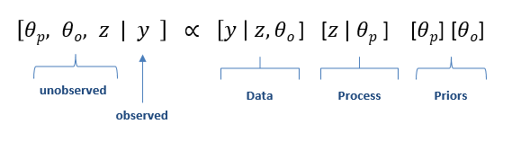
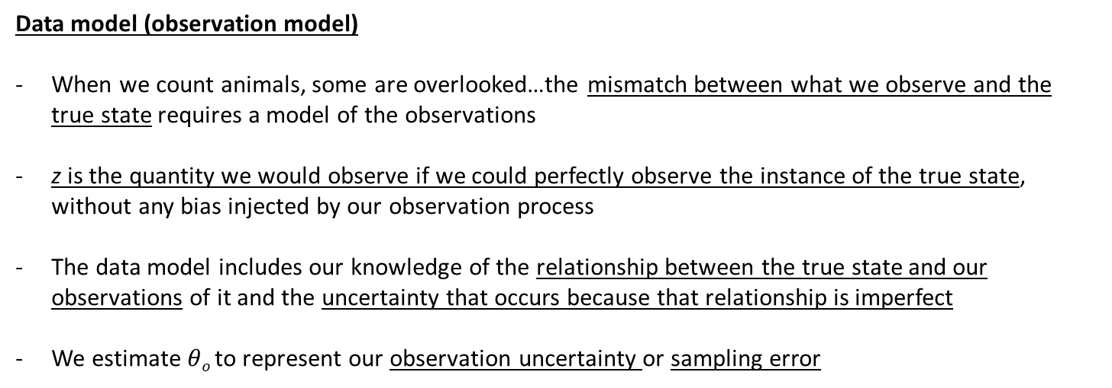
Likelihood
Data model (observation model)
When we count animals, some are overlooked…the mismatch between what we observe and the true state requires a model of the observations
z is the quantity we would observe if we could perfectly observe the instance of the true state, without any bias injected by our observation process
The data model includes our knowledge of the relationship between the true state and our observations of it and the uncertainty that occurs because that relationship is imperfect
We estimate $θo$to represent our observation uncertainty or sampling error
Parameter model (priors)
what we know about the parameters when we began our investigation, that is, our prior knowledge

Slide 36
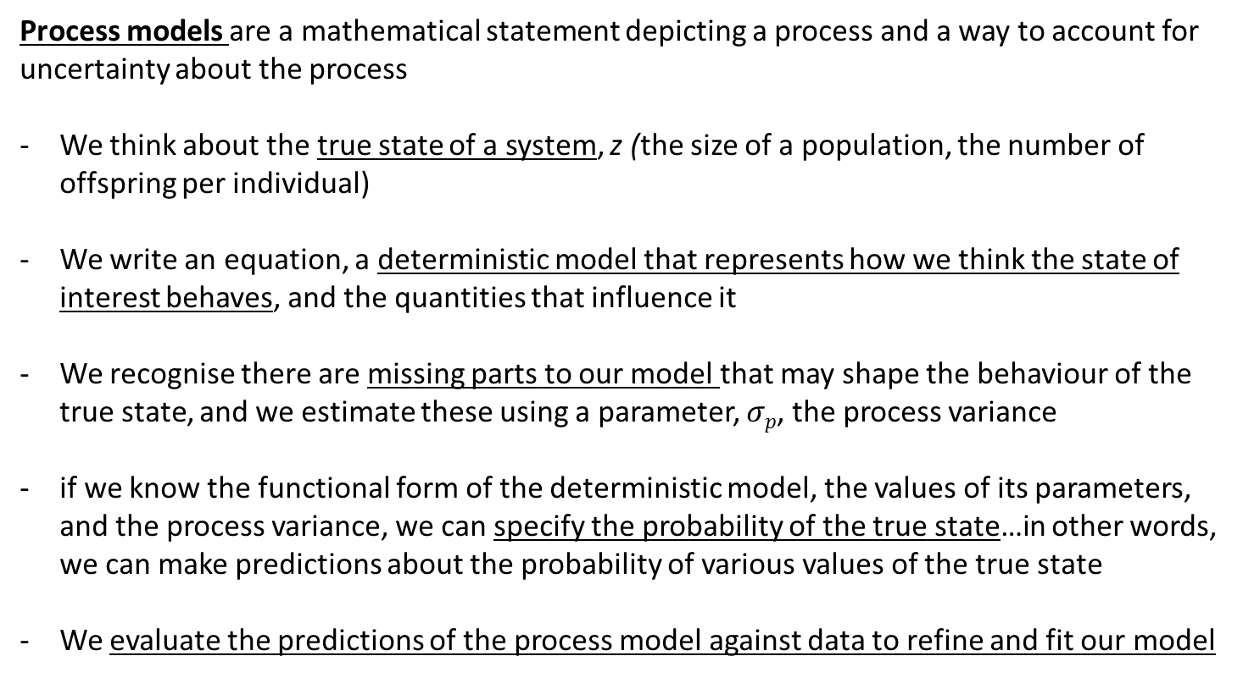
Likelihood
Process models are a mathematical statement depicting a process and a way to account for uncertainty about the process
We think about the true state of a system, z (the size of a population, the number of offspring per individual)
We write an equation, a deterministic model that represents how we think the state of interest behaves, and the quantities that influence it
We recognise there are missing parts to our model that may shape the behaviour of the true state, and we estimate these using a parameter, $σp$, the process variance
if we know the functional form of the deterministic model, the values of its parameters, and the process variance, we can specify the probability of the true state…in other words, we can make predictions about the probability of various values of the true state
We evaluate the predictions of the process model against data to refine and fit our model

Slide 37
Likelihood
data model + process model + priors =
full mathematical expression for:
our ecological process (process model), …
linked to data (data model), …
in a way that includes all sources of uncertainty (observation uncertainty and process uncertainty), …
and allows us to include prior understanding (priors)

Slide 38
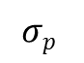
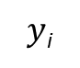
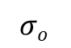
So, what does that look like? How can we use DAGs to help us with our model specification?
$y$_{i}
Data
z_{i}
Process
$$σo$$
$$σp$$
Parameters
Likelihood
$\left[θp, θo, z | y \right] ∝ \left[y \right| z,θo$] [$z | θp$ ] [$θp$] [$θo$]
unobserved
Data
Process
Priors
observed

Slide 39
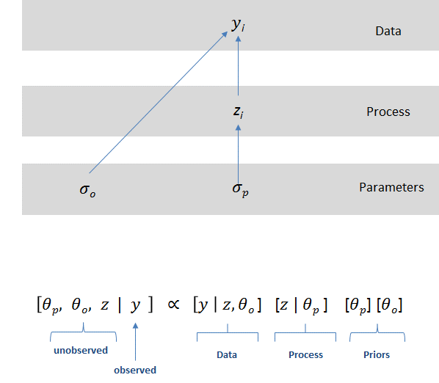
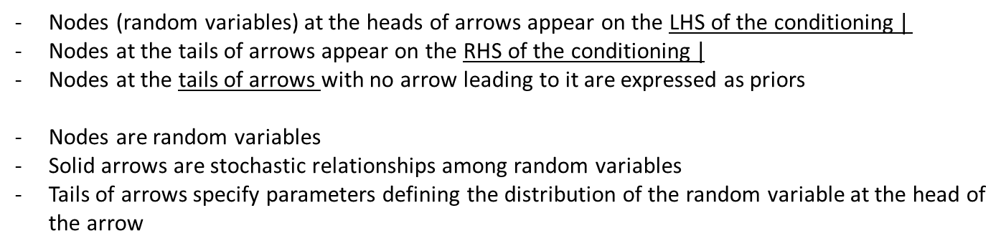
Nodes (random variables) at the heads of arrows appear on the LHS of the conditioning $|$
Nodes at the tails of arrows appear on the RHS of the conditioning $|$
Nodes at the tails of arrows with no arrow leading to it are expressed as priors
Nodes are random variables
Solid arrows are stochastic relationships among random variables
Tails of arrows specify parameters defining the distribution of the random variable at the head of the arrow

Slide 40
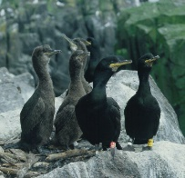
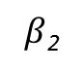
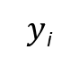
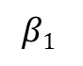
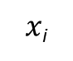
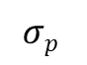
Let’s make this a bit less abstract….variation in processes caused
by variation among individuals
We want to model how the productivity (number of chicks) of shags is affected by the length of time that a pair of shags has been bonded together
We have some data on individual shags (productivity and length of pairing)
First, draw the DAG…
Length of shag partnership
$x$_{i}
$y$_{i}
Productivity of shags (can I detect the chicks in the nest?)
Data
z_{i}
Productivity of shags (true state)
Process
$$β1$$
$β$₂
$$σp$$
Parameters
regression parameter
regression parameter
Process uncertainty

Slide 41
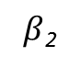
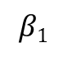
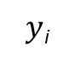
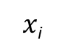
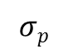
Let’s make this a bit less abstract….variation in processes caused
by variation among individuals
Now use the DAG to factor out the joint distribution for the posterior….
Length of shag partnership
$x$_{i}
$y$_{i}
Productivity of shags (can I detect the chicks in the nest?)
Data
z_{i}
Productivity of shags (actual)
Process
$$β1$$
$β$₂
$$σp$$
Parameters
regression parameter
regression parameter
Process uncertainty
$\left[σp, β1,β2, z | y \right] ∝$
Data model
Process model
Priors

Slide 42
Let’s make this a bit less abstract….variation in processes caused
by variation among individuals
Now use the DAG to factor out the joint distribution for the posterior….
Length of shag partnership
$x$_{i}
$y$_{i}
Productivity of shags (can I detect the chicks in the nest?)
Data
z_{i}
Productivity of shags (actual)
Process
$$β1$$
$β$₂
$$σp$$
Parameters
regression parameter
regression parameter
Process uncertainty
$\left[σp, β1,β2, z | y \right] ∝ \left[y \right| z$] [$z |σp, β1, β2$] [$β$₁] [$β2$] [$σp$]
Data model
Process model
Priors

Slide 43
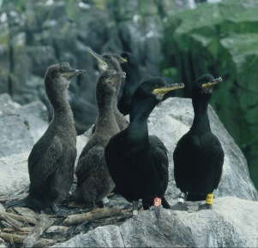
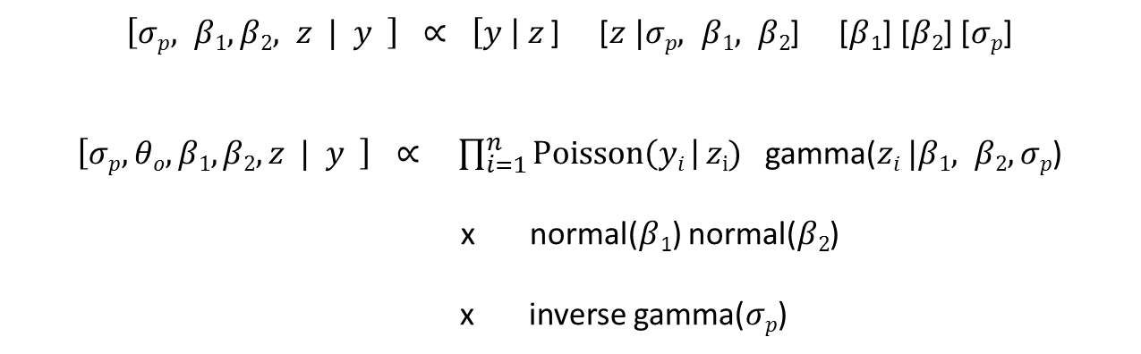
Then we assigning probability distributions to our random variables…
$\left[σp, β1,β2, z | y \right] ∝ \left[y \right| z$] [$z |σp, β1, β2$] [$β$₁] [$β2$] [$σp$]
$\left[σp, θo, β1,β2,z | y \right] ∝$ $\prod_{i=1}^{n}{Poisson\left(yi \right| zi)}$ $\text{gamma}\text{(}zi |β1, β2,σp\text{)}$
x normal($β$₁) normal($β2$)
x inverse gamma($σp$)

Slide 44
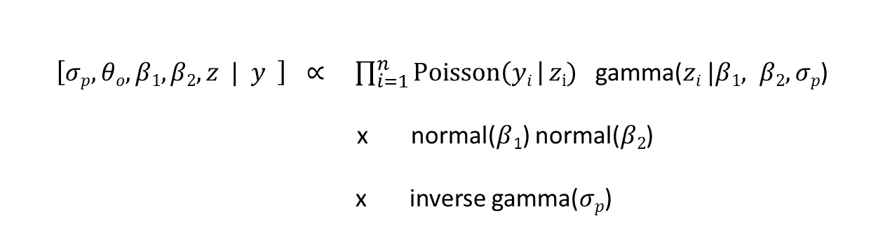
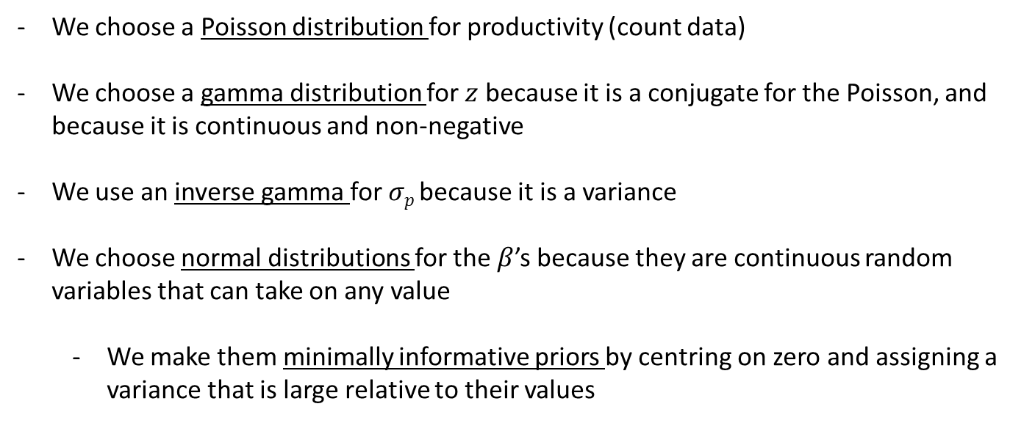
Why did we choose those probability distributions?
$\left[σp, θo, β1,β2,z | y \right] ∝$ $\prod_{i=1}^{n}{Poisson\left(yi \right| zi)}$ $\text{gamma}\text{(}zi |β1, β2,σp\text{)}$
x normal($β$₁) normal($β2$)
x inverse gamma($σp$)
We choose a Poisson distribution for productivity (count data)
We choose a gamma distribution for $z$ because it is a conjugate for the Poisson, and because it is continuous and non-negative
We use an inverse gamma for $σp$because it is a variance
We choose normal distributions for the $β$’s because they are continuous random variables that can take on any value
We make them minimally informative priors by centring on zero and assigning a variance that is large relative to their values

Slide 45


Adding in the process model for productivity…
Process model = $zi=g(β1,β2 xi$) =$β1+β$₂x_{i}
= modelling the process for how productivity is affected by length of partnership
$β1$ is the average productivity of a shag with a partnership of length 0
$β2$ is the parameter that controls how length of partnership affects productivity
$σp$is the process variance or process uncertainty
$\left[σp, β1,β2,z | y \right] ∝$ $\prod_{i=1}^{n}{Poisson\left(yi \right| zi)}$ $\text{gamma}\text{(}zi |g(β1,β2 xi\text{)},σp\text{)}$
x normal($β$₁ $|$0,100) normal($β2|\text{0,100}$)
x inverse gamma($σp |0.001$,0.001)

Slide 46






Moment matching…
$$\text{gamma}\text{(}zi |β1, β2,σp\text{)}$$
$\left[σp, β1,β2,z | y \right] ∝$ $\prod_{i=1}^{n}{Poisson\left(yi \right| zi)}$ $\text{gamma}\text{(}zi |\frac{g(β1,β2 xi\text{)}2}{σp},\frac{g(β1,β2 xi\text{)}}{σp}\text{)}$
x normal($β$₁ $|$0,100) normal($β2|\text{0,100}$)
x inverse gamma($σp |0.001$,0.001)
What’s going on here?
Process model = $zi=g(β1,β2 xi$) =$β1+β$₂x_{i}
Our process model predicts the mean (or sometimes the median) of a distribution, but…
the parameters for the gamma distribution are not the mean and the variance – they are the shape and the rate
We need to be able to calculate parameters from the mean and the variance…

Slide 47

What about sampling variance/observation error?
There is an explicit parameter for the process variance, $σp$, but there does not appear to be a parameter controlling variance in the observations, y_{i}
Does this mean we are assuming no observation variance? No…
Because the Poisson distribution assumes the variance is the same as the mean, so observation variance is implicit in the likelihood

Slide 48


$\left[σp, β1,β2,z | y \right] ∝$ $\prod_{i=1}^{n}{Poisson\left(yi \right| zi)}$ $\text{gamma}\text{(}zi |\frac{g(β1,β2 xi\text{)}2}{σp},\frac{g(β1,β2 xi\text{)}}{σp}\text{)}$
x normal($β$₁ $|$0,100) normal($β2|\text{0,100}$)
x inverse gamma($σp |0.001$,0.001)
Why doesn’t the dataset, x (length of partnership), appear in the posterior distribution?
The x are not treated as random variables in this formulation – we assume the x data are perfectly observed and fixed, while the y data are random variables
This means the x are known, fixed quantities, treated no differently than a constant – they are not random variables and therefore should not appear in the expression for the posterior distribution, which by definition, is composed of random variables
The predictor variables do appear as arguments to the deterministic function for shag productivity:
Process model = $g(β1,β2 xi$)

Slide 49

Why do we need to do this again (…my head hurts)?
clear, transparent science (What have we left out? What are our uncertainties?)
We need to be able to express the posterior distribution as a set of joint factored likelihoods in order to fit our models in any software package
E.g., JAGS – the ‘model statement’ in JAGS is the joint distribution for the posterior of your model…
$\left[σp, β1,β2,z | y \right] ∝$ $\prod_{i=1}^{n}{Poisson\left(yi \right| zi)}$ $\text{gamma}\text{(}zi |\frac{g(β1,β2 xi\text{)}2}{σp},\frac{g(β1,β2 xi\text{)}}{σp}\text{)}$
x normal($β$₁ $|$0,100) normal($β2|\text{0,100}$)
x inverse gamma($σp |0.001$,0.001)

Slide 50
Part 2: implementing our model using MCMC (R and JAGS)
Implement the model using your expression for the posterior and joint distributions
$\left[σp, β1,β2,z | y \right] ∝$ $\prod_{i=1}^{n}{Poisson\left(yi \right| zi)}$ $\text{gamma}\text{(}zi |\frac{g(β1,β2 xi\text{)}2}{σp},\frac{g(β1,β2 xi\text{)}}{σp}\text{)}$
x normal($β$₁ $|$0,100) normal($β2|\text{0,100}$)
x inverse gamma($σp |0.001$,0.001)

Slide 51
PRACTICAL

Slide 52



Exercise 1: Modelling light limitation of Hemlock tree growth
The relationship between tree growth rate and light tends to be non-linear, approaching an asymptote under high light conditions
Here, we model this simple curve using a Bayesian approach, where our response (y) is observed growth rate and our only predictor variable is light (L) = process model
Michealis-Menton equation
Process model = $g(α, γ, c,Li$) =
$α$ = max. growth at infinite light
$γ$ = rate at which curve tails off
$$c=light level at which growth is zero (x intercept)$$

Slide 53






Hierarchical Bayesian model…
Observations made with error
Dotted line because we are assuming the covariate is known and fixed – it does not appear in the joint distribution for the posterior…
$L$_{i}
$y$_{i}
Data
Unobserved true state
$$μi$$
Process
Process uncertainty
Observation uncertainty
$$σo$$
$$α, γ, c$$
$$σp$$
Priors

Slide 54








Hierarchical Bayesian model…
Dotted line because we are assuming the covariate is known and fixed – it does not appear in the joint distribution for the posterior…
$L$_{i}
$y$_{i}
Data
$$μi$$
Process
Process uncertainty
Observation uncertainty
$$σo$$
$$α, γ, c$$
$$σp$$
Priors
$\left[α, γ, c,μi ,σp,σo| yi \right] ∝ \left[yi \right| μi,σo$]
x $\left[μi \right| g(α, γ, c),σp$]
x [$α$] [$γ$] [c] [$σp$] [$σo$]
Likelihood
unobserved
observed
Priors
Process model = $g(α, γ, c,Li$) = $μi=$

Slide 55



$\left[α, γ, c,μi ,σp,σo| yi \right] ∝ \left[yi \right| μi,σo$]
x $\left[μi \right| g(α, γ, c),σp$]
x [$α$] [$γ$] [c] [$σp$] [$σo$]
Likelihood
unobserved
observed
Priors
Process model = $g(α, γ, c,Li$) = $μi=$
We choose a normal distribution for y growth rate (can be + or -)
We choose a normal distribution for $z$ because it is a conjugate for the normal, and because it can be + or -
We use a normal for $σo$because we have prior knowledge about the mean and variance of our observation error
We use a uniform for $σp$ because we know the process variance is positive and bounded within a sensible range
We choose gamma distributions for the $α and γ$ because they are positive random variables
We choose a uniform for c because we know it is bounded on the x-axis
We make them minimally informative priors by centring on zero and assigning a variance that is large relative to their values (normal) or placing most of the density mass at zero (gamma)

Slide 56
2a. Fit hierarchical Bayesian model in R and JAGS…

Slide 57


Likelihood
Priors

Slide 58


Slide 59

Brief notes on model convergence…more later in the course

Slide 60

Trace plots provide an important tool for assessing mixing of a chain. Density plots are smoothed histograms of the samples, that is they show the function that we are trying to explore – the posterior density of our unobserved parameter…
Burn-in
It is standard practice to discard the initial iterations of iterative simulation as they are too strongly influenced by starting values and do not provide good information about the target distribution
n.eff
the effective sample size, that is an estimate for the number of independent samples (taking into account autocorrelations) generated by the MCMC run

Slide 61
Convergence
Our usual approach is, for each parameter or quantity of interest,
compute the variance of the simulations from each chain
average these within-chain variances = average within-chain variance
Then compare this to the variances of all the chains mixed together = mixture variance
We take the mixture variance divided by the average within-chain variance, compute the square root of this ratio, and call it R.hat or the “potential scale reduction factor” (Gelman and Rubin, 1992, following ideas of Fosdick, 1959).
At convergence, the chains will have mixed, so that the distribution of the simulations between and within chains will be identical, and the ratio R.hat should equal 1. If R.hat is greater than 1, this implies that the chains have not fully mixed and that further simulation might increase the precision of inferences.
In practice we typically go until R.hat is less than 1.1 for all parameters and quantities of interest
http://www.mcmchandbook.net/HandbookChapter6.pdf

Slide 62
2b. Fit hierarchical Bayesian model with multiple sites in R and JAGS…

Slide 63











Hierarchical Bayesian model…now with multiple sites, j
$Li$_{,j}
$yi$_{,j}
1
2
Data
3
$$μi,j$$
Process
$$σo$$
$$αj, γ, c$$
$$σp$$
Parameters
α₂
α₃
α₁
$$μα$$
$$σα$$
Hyper-parameters
Multiple sites, j, and we expect there to be differences in the maximum growth rate per site, α_{j}, for instance due to soil water availability
$\left[αj, γ, c, σp , μα, σα| yi,j \right] ∝ \left[yi,j \right| g(αj, γ, c),σp$]
$\left[αj \right| μα, σα$]
[$μα$] [$σα$] [$γ$] [c] [$σp$]
Process model = $g(α, γ, c,Li$) = $μi=$

Slide 64


Slide 66
END

Slide 67
EXTRA SLIDES

Slide 68


Slide 69


Slide 70


Slide 71


$\left[θp, β, z | y \right] ∝ \left[y \right| z$] [$z | β, θp$ ] [$β$] [$θp$]
$\left[θp, θo, β, z | y \right] ∝$ $\prod_{i=1}^{n}{binomial\left(yi \right| zi)}$
$\prod_{i=1}^{n}{\text{beta}\text{(}zi | β, θp\text{ )}}$
normal($β$)
inverse gamma($θp$)

